Slide 1
ADC Peripheral and Configuration
R&D BLR

Slide 2
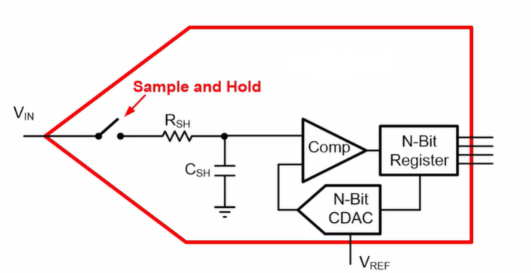
SAR ADC Block Diagram
SAR ADC

Slide 3
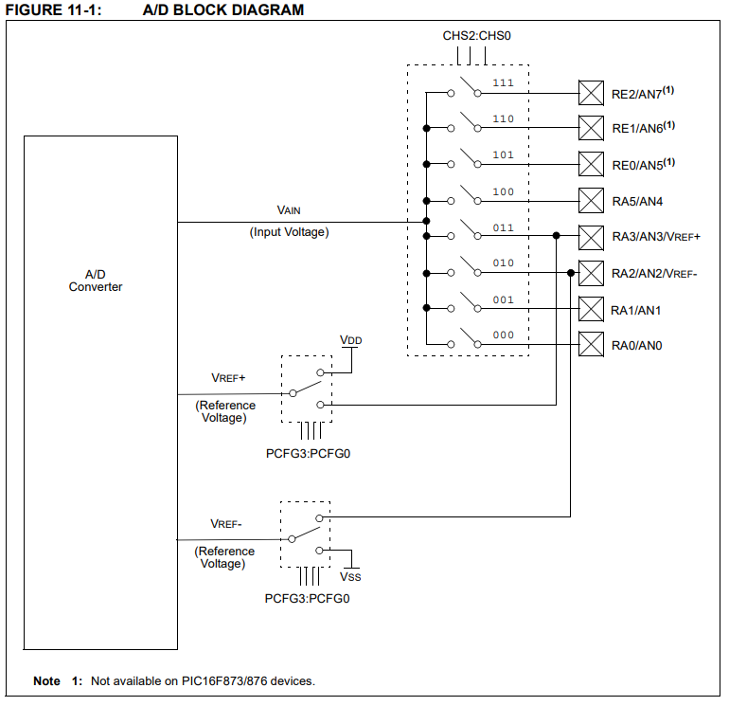
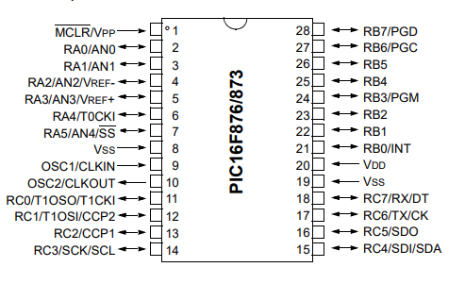
10-bit A/D Block Diagram
ADC Resolution:
2^n - 1

Slide 4
A/D module Registers
Special Function Registers (SFRs)
Data register
Control register
Status register
The A/D module has four registers.
A/D Control Register0 (ADCON0)
A/D Control Register1 (ADCON1)
A/D Result High Register (ADRESH)
A/D Result Low Register (ADRESL)

Slide 5
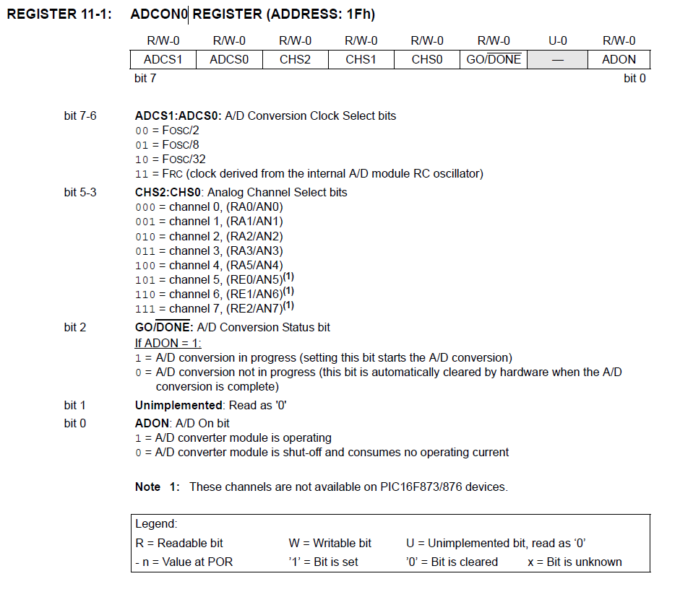

Control Register (ADCON0)

Slide 6
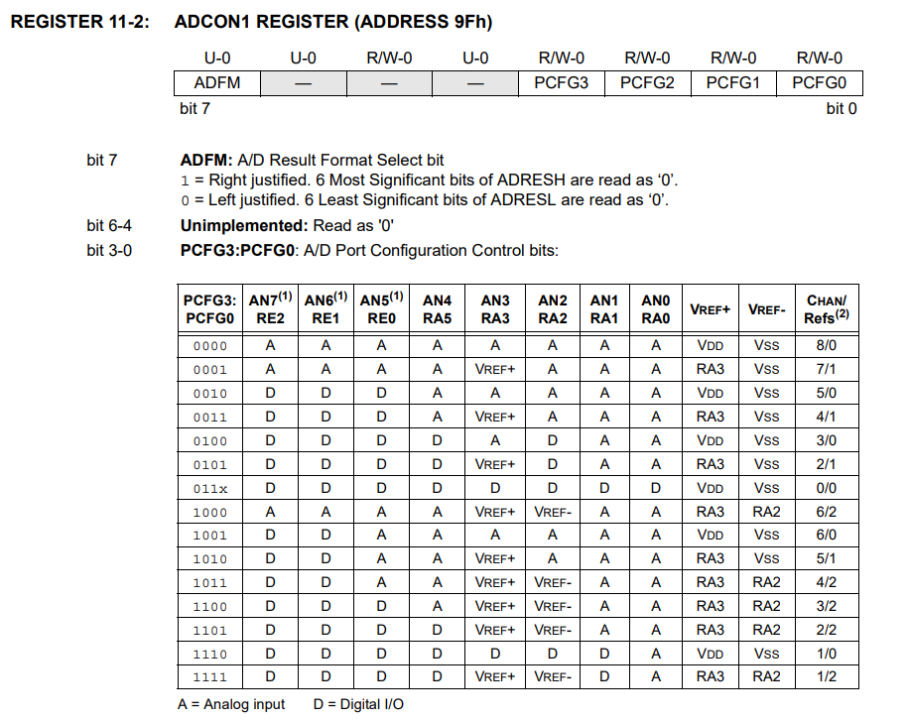


Control Register (ADCON1)

Slide 7
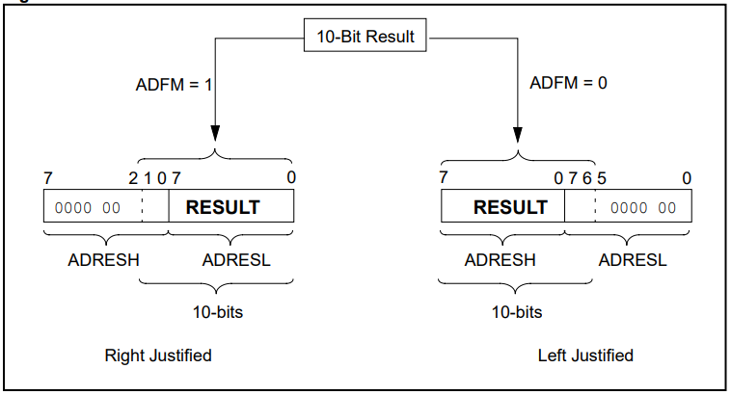
A/D Result Register (ADRESH:ADRESL)
The ADRESH:ADRESL registers contains the 10-bit result of the A/D conversion.
When the A/D conversion is complete, the result is loaded into this A/D result register pair, the GO/DONE bit (ADCON0) is cleared.

Slide 8
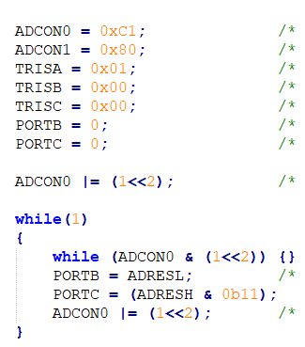
A/D Conversion Operation
Steps for doing an A/D conversion:
Configure the A/D module:
Configure analog pins / voltage reference/ and digital I/O (ADCON1)
Select the A/D Conversion Clock
Select A/D input channel (ADCON0)
Select A/D conversion clock (ADCON0)
Turn on A/D module (ADCON0)
Wait the required acquisition time.
Start conversion:
Set the GO/ DONE bit (ADCON0)
Wait for A/D conversion to complete
Read A/D result register pair (ADRESH:ADRESL)
For the next conversion, go to step 1 or step 2, as required.

Slide 9
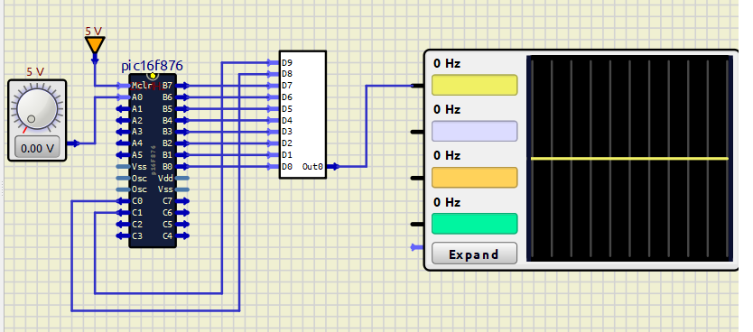
Requirements for ADC
Configure Port RA0/AN0 : Pin 2 of PIC as analog input PIN.
Use ADC internal clock as source.
Right justify the ADC Results.
Use Port B and Port C to output the ADC Results.
Use DAC for converting Port Output to Voltage.

Slide 10
Program
#include <xc.h>
void main(void)
{
ADCON0=0xC1;
ADCON1=0x80;
PORTB=0;
TRISB=0;
TRISC=0;
TRISA0=1;
ADCON0=(ADCON0|(0b00000100));
while(1)
{
while(ADCON0 &(0b00000100))
{ }
PORTB = ADRESL;
PORTC= ADRESH & 0b00000011;
ADCON0=(ADCON0|(0b00000100));
}
}

Slide 11
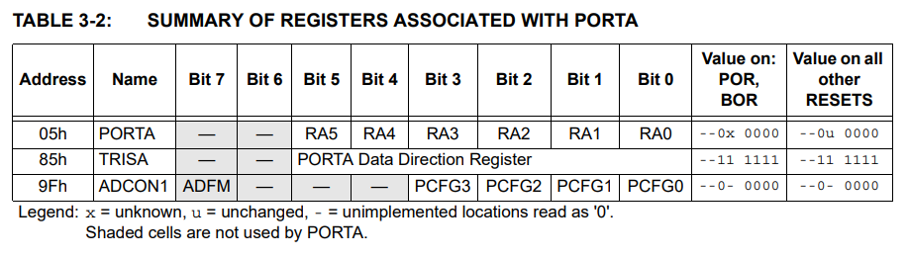
Port A GPIO registers
Configuring Port Pins
Setting a TRISA bit (= 1) will make the corresponding PORTA pin an input

Slide 12
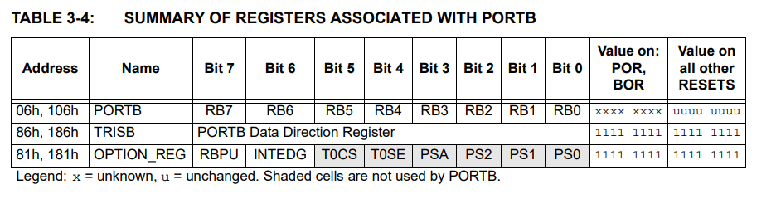
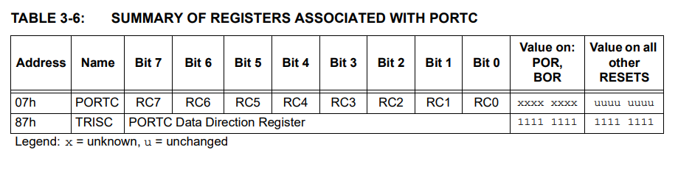
Port B & C – GPIO registers
Configuring Port Pins
Setting a TRISB/C bit (= 1) will make the corresponding PORTB/C pin an input

